Slide 1
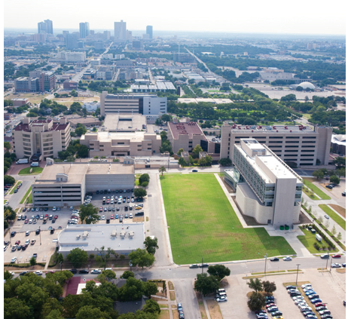
Financial Aid Office
Making Education Possible

Slide 2
Applying for AID
StudentAid.gov
2024-2025 FAFSA
Apply every year October 1st
Opened December 31st this year only
UNTHSC school code: 009768
Uses 2022 tax information
Applying sooner is better, some programs are first come first served (ex: grant funds)

Slide 3
When Will I be Awarded?
We will begin awarding mid May with notifications sent to your HSC email
Will also be viewable on the MyHSC student portal

Slide 4
Types of AID
Scholarships
General Scholarship Application (all programs February – May)
Check website for updated external opportunities
Grants
Determined by FAFSA submission date and Student Aid Index (SAI)
Work Study
  Must have room in your Cost of Attendance (funds are need based)
  Your responsibility to find a job on campus (posted on website)
Loans

Slide 5
Loan Information
Unsubsidized Loan – 7.05% fixed interest rate
Federal Loan Origination fees from each disbursement of 1.057%
Can only award up to your Cost of Attendance (COA) per year
ALL AID will be split evenly among your terms each year (ex. fall/spring or summer/fall/spring if enrolled in summer)
Check website for other loan options if not awarded up to COA
Must be enrolled at least half time to qualify for loans
BUDGET AND PLAN AHEAD FOR EXTRA EXPENSES BETWEEN TERMS!!

Slide 6
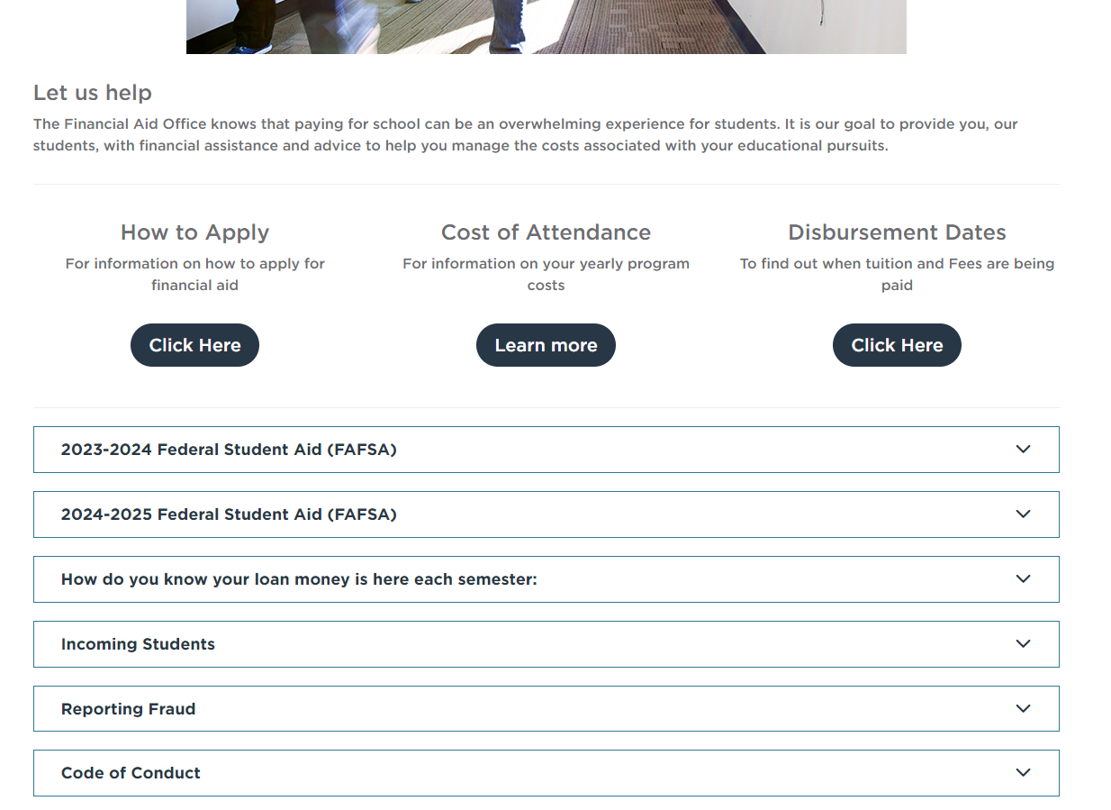
Online Resource
Our homepage: we post important updates here and the most looked for information.
https://www.unthsc.edu/financial-aid/

Slide 7
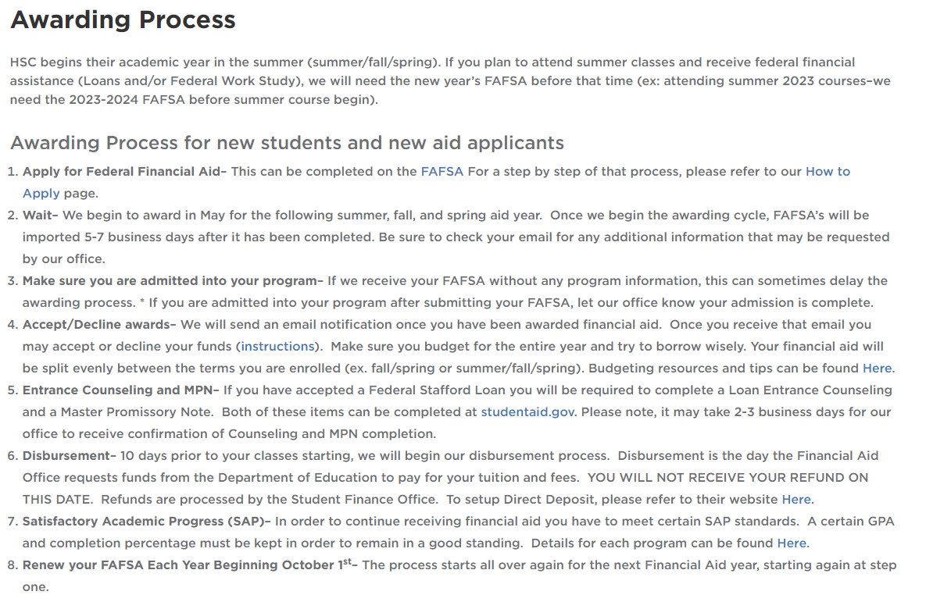
Online Resource
This is a quick step by step to go over the Financial Aid process for incoming students.

Slide 8
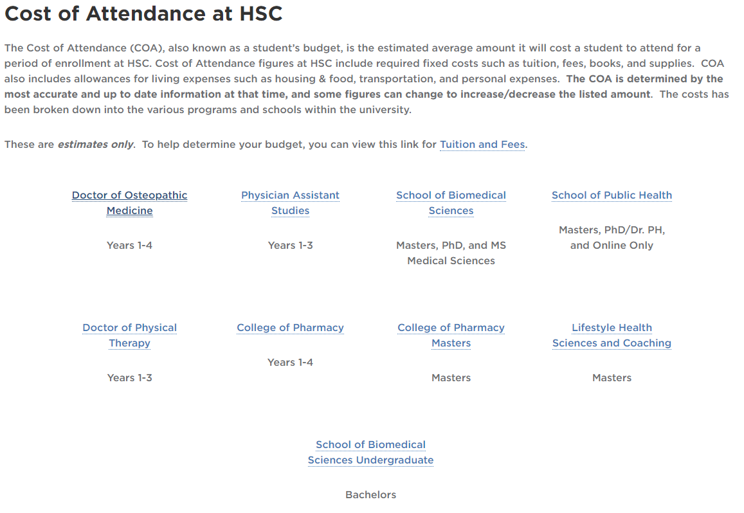
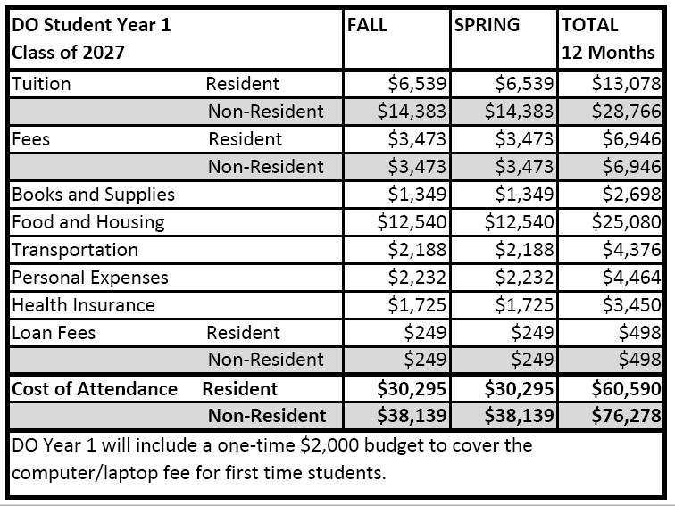
Online Resource
Example
Each program is given a Cost of Attendance for the year. This includes tuition, fees, along with other expenses (see chart to the right).

Slide 9
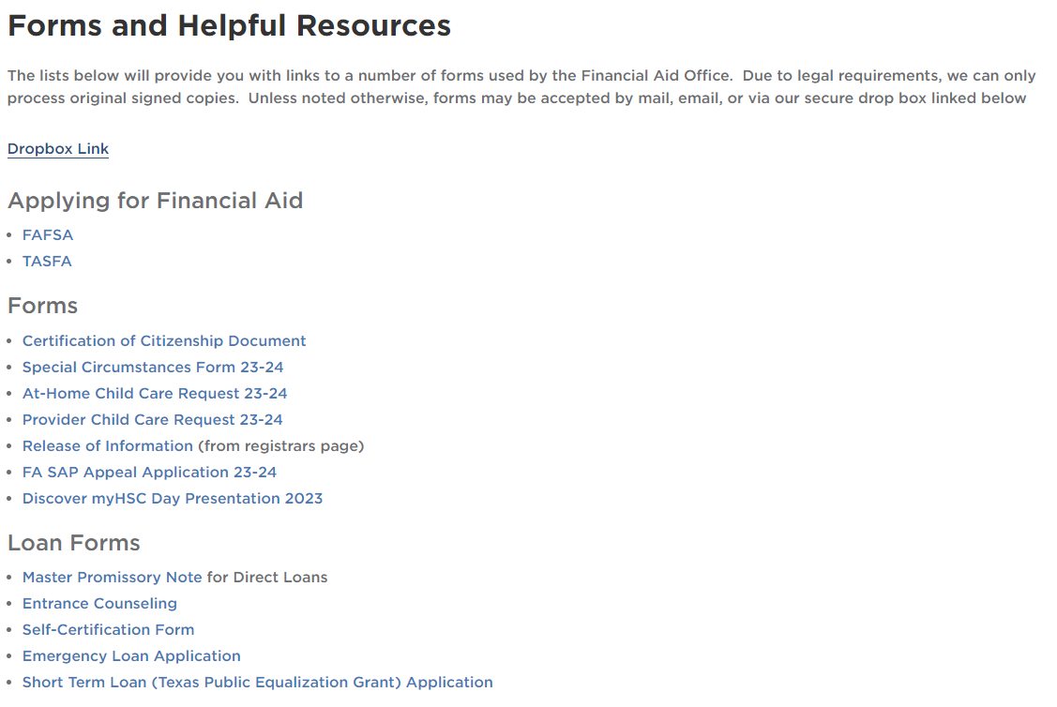
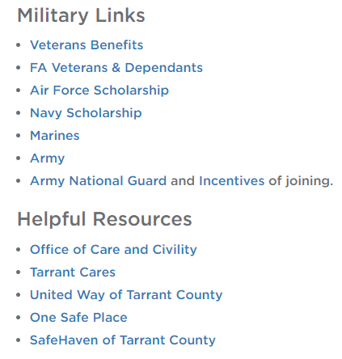
Online Resource
This page contains all the links and forms you need in one place.
We also have military links as well as other helpful county/city related resources.

Slide 10
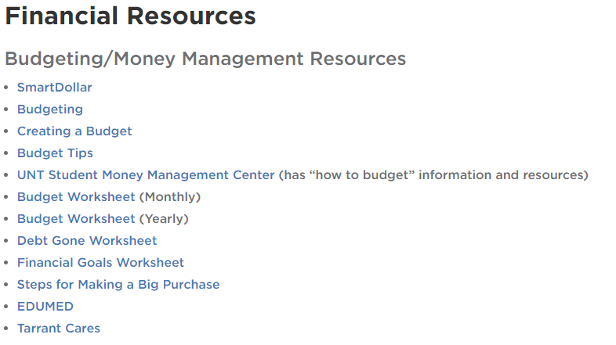
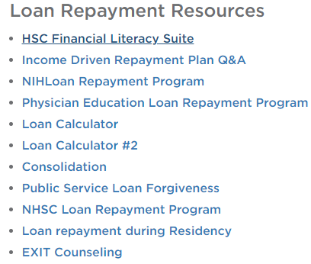
ONLINE RESOURCES
This page contains all financial resources in one place

Slide 11
Where to get Information
Student Portal – Online (https://www.unthsc.edu/myhsc)
Tuition and fees owed – your bill
Financial Aid awarded
Holds – what they are and how to remove them
Registrar’s Office (https://www.unthsc.edu/registrar/)
Verification of enrollment
Deferment of prior loans
Financial Aid Office (https://www.unthsc.edu/financial-aid/)
Verification of Financial Aid award
Applying for Scholarships or Loans
Disbursement
Student Financials Office (https://www.unthsc.edu/student-finance/)
Refund questions
Tuition and fee charges
HSC Student Health (https://www.unthsc.edu/students/student-health/insurance-and-billing)
Student Health Insurance

Slide 12

Staying Connected
Familiarize yourself with our website
www.unthsc.edu/financial-aid
Read your e-mails
Primary form of contact with you
The subject line will have: HSC Financial Aid
Add us to your “Favorites” so it does not filter into junk/spam folder
Location: SSC 150
finaid@unthsc.edu
scholarships@unthsc.edu
Phone: (817) 735-2626
Live Chat on Financial Aid site
Speak with a Financial Aid Counselor through LIVE CHAT on our website

