Slide 1
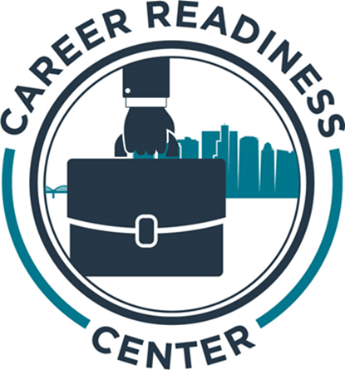
HSC Career Readiness Center

Slide 2
Journaling: Know Thyself!
Talents
What are your greatest talents or skills?
Which of your talents or skills gives you the greatest sense of pride or satisfaction?
Traits/Qualities
What are your five greatest strengths?
What do you feel are your two biggest “weaknesses?”
What qualities or traits do you most admire in others?

Slide 3
Values
What are ten things that are really important to you?
What are the three most important things to you?
What are the values that you hold nearest to your heart?
Perception
How is the “public you” different from the “private you?”
What do you want people to think and say about you?
Is it more important to be liked by others or to be yourself? Why?
Accomplishments
What three things are you most proud of in your life to date?
What do you hope to achieve in life?
If you could accomplish only one thing before you died, what would it be?

Slide 4
Marketable Skills: Also Known As…
“Soft Skills”
Transferrable Skills
Power Skills
People Skills
Emotional Intelligence
Professionalism/Etiquette

Slide 5
A Better Definition
Marketable Skills
=
Career Readiness

Slide 6
Why?
Produce the best equipped and most qualified Professionals of the Future who are sought after by employers to fill the most desirable positions.

Slide 7
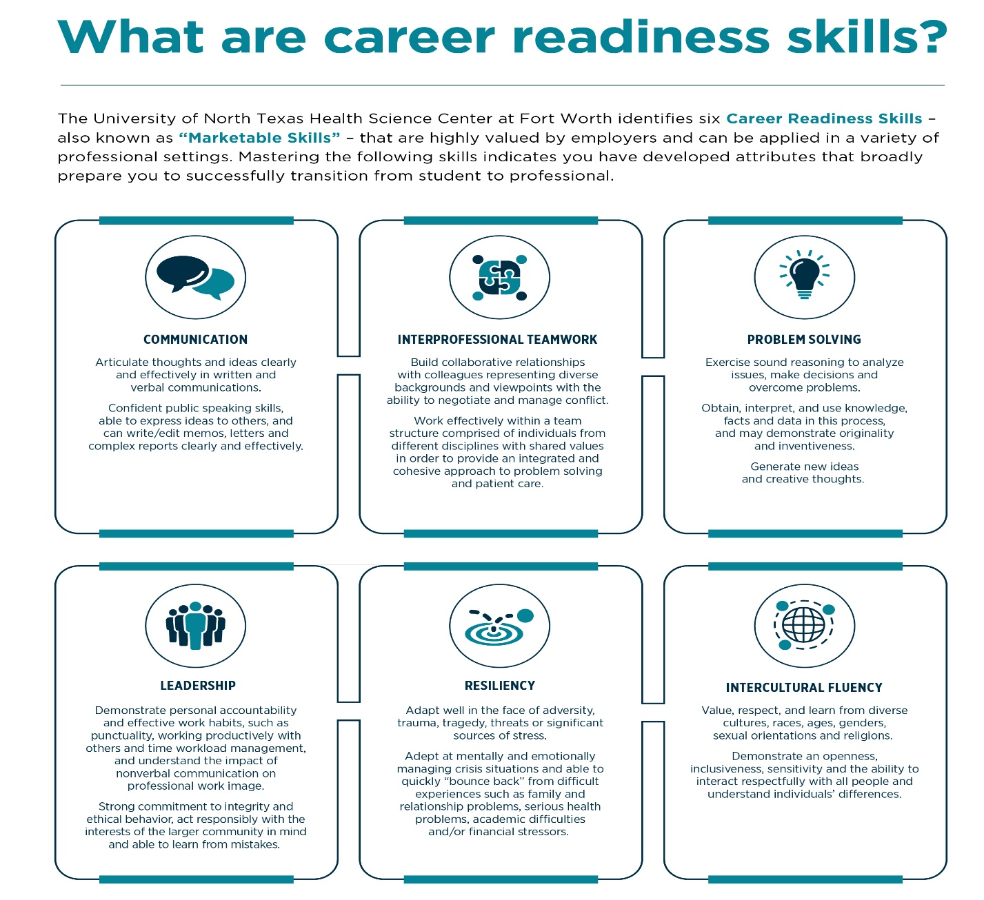

Slide 8
National Association of Colleges and Employers (NACE) – Annual Survey
The Key Attributes Employers Seek on College Graduates’ Resumes
ATTRIBUTE | % OF RESPONDENTS SEEKING FOR CLASS OF 2022 | % OF RESPONDENTS SEEKING FOR CLASS OF 2021
Problem-solving skills | 85.5% | 79.0%
Analytical/quantitative skills | 78.6% | 76.1%
Ability to work in a team | 76.3% | 81.0%
Communication skills (written) | 73.3% | 72.7%
Initiative | 72.5% | 67.8%
Strong work ethic | 71.0% | 65.4%
Technical skills | 64.9% | 67.8%
Flexibility/adaptability | 63.4% | 65.9%
Detail-oriented | 62.6% | 56.1%
Leadership | 60.3% | 67.8%
Communication skills (verbal) | 58.8% | 73.2%
Interpersonal skills (relates well to others) | 56.5% | 57.6%
Source: Job Outlook 2022 and Job Outlook 2021, National Association of Colleges and Employers
https://www.naceweb.org/about-us/press/the-key-attributes-employers-seek-on-college-graduates-resumes/

Slide 9
CV/Resume Resources
https://www.unthsc.edu/career-center/

Slide 10
Who do you aspire to be in 5-10 years?
What will your education look like?
What will your experiences look like?
What are your values, skills, and strengths?
What else do you hope to accomplish?
- OR -
If you wanted to apply for a job today, what would you say?

Slide 11
Lifelong Learning Will Be the New Normal—But Are We Ready?
The most valuable workers now and in the future will be those who can combine technical knowledge with human skills and adapt to the changing needs of the workplace.
https://www.pewtrusts.org/en/trend/archive/spring-2020/lifelong-learning-will-be-the-new-normal-but-are-we-ready

Slide 12
It’s not just about what you know, or even who you know, maybe more so who you know who knows what you know!
(…and how you behave)

Slide 13
Career Readiness Center Overview​
The Career Readiness Center offers comprehensive advising and resources to assist current and former students in achieving their career goals: https://www.unthsc.edu/career-center/
Resume/CV Building (including professional school applications)​
Personal Statement and Cover Letter Writing​
Interviewing and Professional Etiquette Skills​
Social Media Profile Development​
Job Fairs and Networking Events
On-campus Student Employment
Individual Career Exploration (including assessment)

Slide 14
HSC Career Readiness Center​ How to reach us​
Careercenter@unthsc.edu
Appointments (schedule through Symplicity)​
https://www.unthsc.edu/students/career-center/
Cassie Ardry​
Director​ of the Career Readiness Center
Cassie.ardry@unthsc.edu
Nyjah Lane​
Career Consultant ​
Nyjah.lane@unthsc.edu

