Slide 1
Student Health Insurance, Immunizations, & Clinic
Pre-Arrival Orientation 2024-2025

Slide 2
Agenda
Pre-Travel Planning
Healthcare Options
HSC Student Health Clinic
Health Insurance Overview
Immunization Requirements

Slide 3
Pre-Travel Planning

Slide 4
Pre-Arrival Checklist
Before you travel to the US, consider visiting you doctor, dentist, and eye doctor for a general checkup to:
Obtain a copy of your medical records
Refill your prescriptions
Have a current prescription for glasses and contact lenses
Make sure your vaccines are up to date

Slide 5
Healthcare Options

Slide 6
US Healthcare Overview
The US healthcare system, although great, is likely very different from what you are used to. It can be complex and expensive, which is why health insurance is important to have.
The cost of coverage is paid by you, and the insurance pays for most of your medical care.
When you seek medical care, make sure the provider you choose accepts your insurance to avoid out of network costs.
Although your insurance will likely cover most of your expenses, be prepared to pay some portion of cost for your medical care, such as a copay, deductible, or coinsurance.

Slide 7
Seeking Healthcare Services
There are several types of healthcare facilities in the US, each with their own specialty or use.
Hospital – for specialized medical or surgical treatment, often requiring an overnight stay. ($$$)
Emergency Room – for life threatening illness or injuries only ($$$)
Urgent Care Clinic – walk-in clinic for acute minor illness and injury only. ($$)
Doctors’ Office – for general care, including annual visits, medication management, vaccines, and minor illness/injuries ($)
The Student Health Clinic is convenient and provides access to quality health services at an affordable cost.

Slide 8
Student Health Clinic

Slide 9
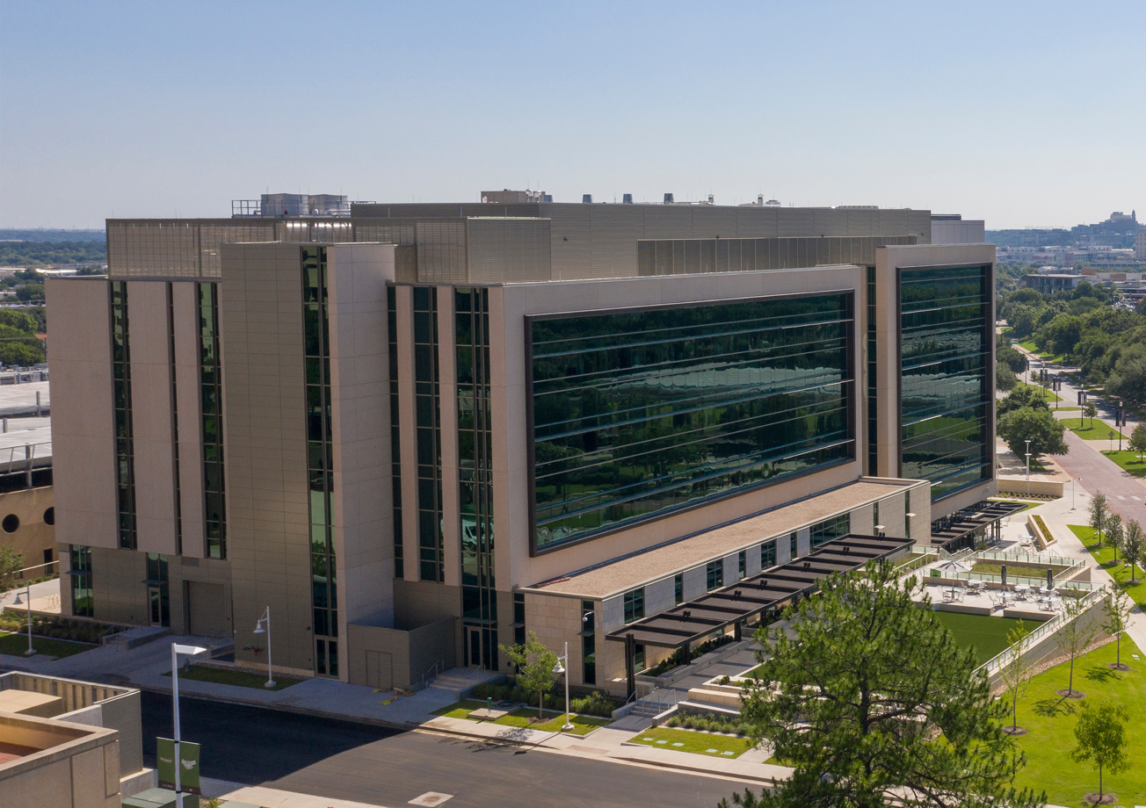
Student Health Clinic
Conveniently located on campus in the
IREB, 1st Floor
3430 Camp Bowie Blvd, Fort Worth, TX 76107
Hours of Operation:
Monday, Thursday 7am – 4pm
Tuesday, Wednesday, Friday 8am - 5pm
Schedule an appointment by phone or online!
817-735-5051
unthsc.edu/studenthealth
No walk-ins, please.

Slide 10
Services
Success starts with your physical and mental wellness. We offer convenient same-day or next-day appointments with in-person and virtual options available.
Our services include:
Primary Care – acute minor illness & injuries
Preventive Health – physical exams, immunizations, screenings
Reproductive Health – Well woman exams, contraception, STI testing
Laboratory Services – Titers and lab orders
Mental Health – Psychiatric care and counseling services

Slide 11
Health Insurance Overview

Slide 12
Insurance Requirement
HSC policy and state law requires all students to have health insurance. International students are automatically enrolled in the Student Health Insurance plan with United Healthcare UNLESS proof of comparable coverage is provided.
What is considered comparable coverage?
Have a government-sponsored insurance plan provided by your home government that is funding your tuition and cost of living while attending HSC
Have a health insurance coverage through a U.S. employer group policy OR be a dependent on a spouse or family member's policy through a U.S. employer group
Repatriation insurance coverage of at least $10,000*
Evacuation insurance coverage of at least $7,500.*
*If your plan does not include repatriation and evacuation, but meets all other criteria, a separate policy covering evacuation and repatriation insurance may be purchased.

Slide 13
Student Health Insurance Plan
The Student Health Insurance Plan is offered through United Healthcare Insurance and the policy is effective August 10, 2024 – August 9, 2025.
For a full description of coverage, including costs, benefits, exclusions, any reductions or limitations and terms under which the policy may be continued in force, please visit unthsc.myahpcare.com.
Rates for 2024 – 2025:

Slide 14
If you have the Student Health Insurance and use the Student Health Clinic, most services are covered 100% and there is NO COPAY!!

Slide 15
Immunization Requirements

Slide 16
Required Immunizations & Screenings
Hepatitis B titer (quantitative titer)
Measles, Mumps, Rubella (MMR)
Varicella (chickenpox)
Tetanus, Diphtheria, Acellular Pertussis (TDAP)
Tuberculosis (TB) Screenings – annually
Influenza – annually
Meningitis (age 21 and under)
Physical exam – SBS/SPH Exempt
Details for each requirement can be found online at unthsc.edu/studenthealth
under the “Immunization Requirements” tab.

Slide 17
If you are needing immunizations or screenings for compliance, you can schedule an appointment with the Student Health Clinic by calling 817-735-5051!

Slide 18
Please note: While the university may accept many policies of insurance with comparable coverage, the Student Health Clinic may not. If you plan to utilize the Student Health Clinic, please call 817-735-5051 to see what plans are accepted prior to selecting a policy.

Slide 19
For more information, visit unthsc.edu/studenthealth.
Student Health Insurance & Immunization Requirements
Tina Hay - Student Health Coordinator
817-735-5054
Student Health Insurance: health@unthsc.edu
Immunization Compliance: studenthealth@unthsc.edu
HSC Student Health Clinic
IREB, 1st Floor
3430 Camp Bowie Blvd
817-735-5051, option 3

