Slide 1


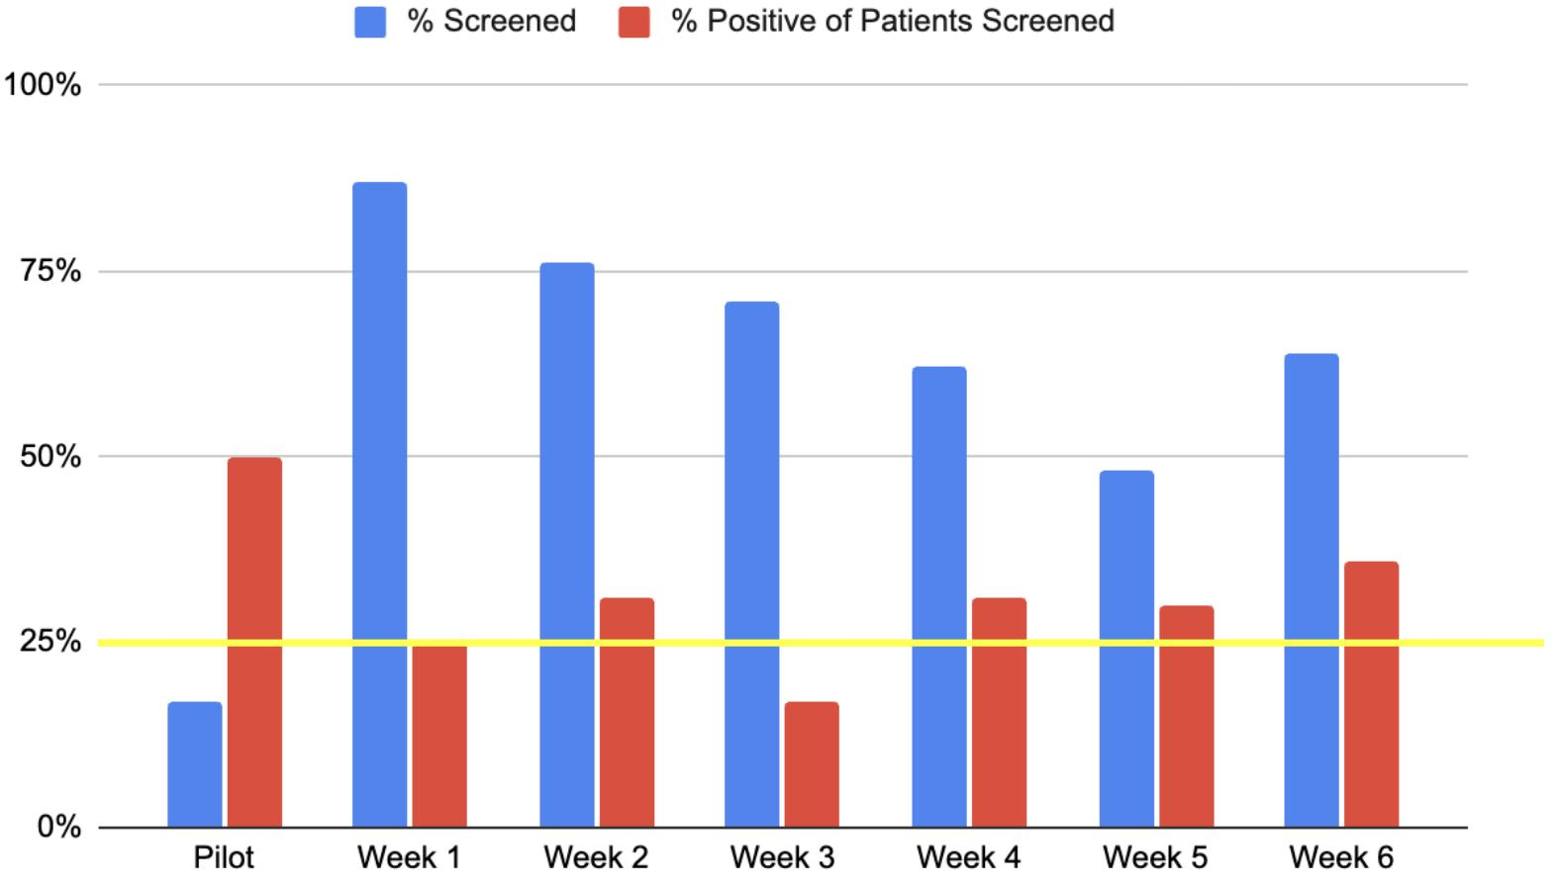
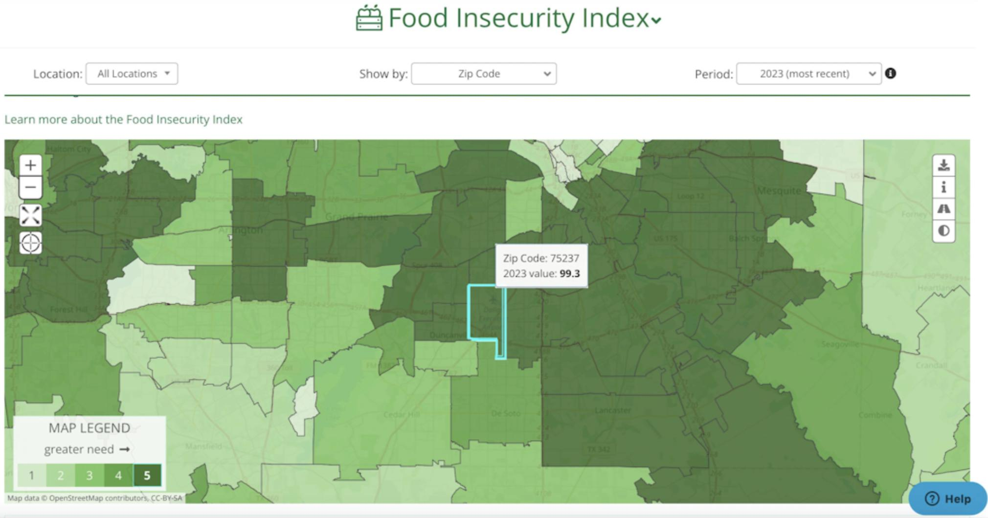
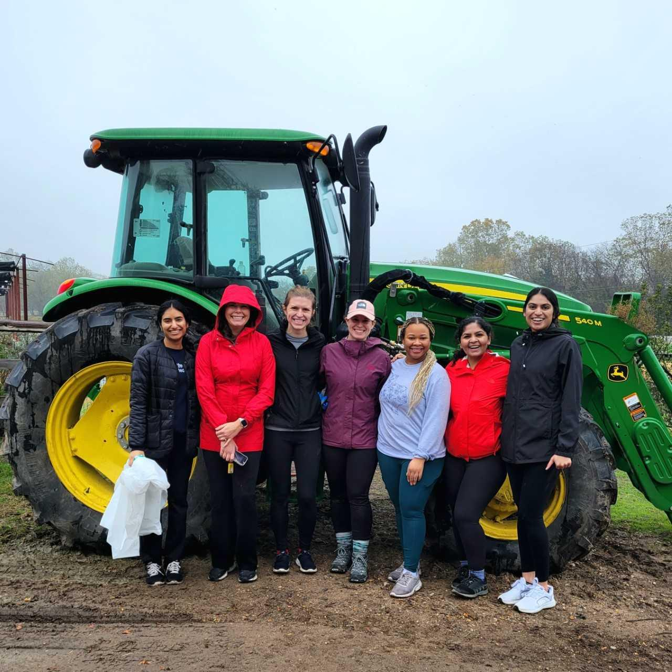
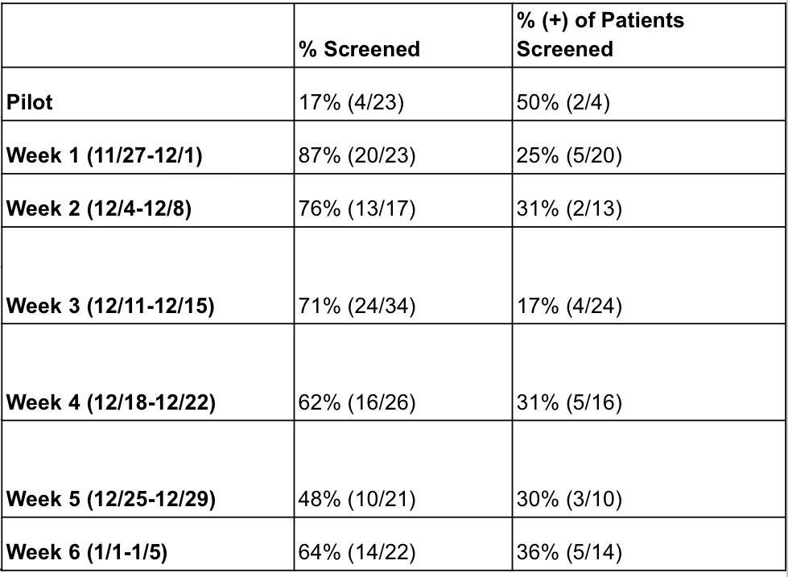


Food Insecurity Screening During Annual Wellness Visits
Rozen Gilerman, D.O.; Daeija Lewis, D.O.; Caroline Kelley, D.O.; Hope Shepherd, M.D.
AIM & BACKGROUND
CHANGES
RESULTS: Figure 2
KEY LEARNINGS
  BACKGROUND
  Food insecurity has reached unprecedented levels post-pandemic. We daily see patients who are unable to obtain healthy food for their families.
  AIM STATEMENT
  The goal of our quality improvement project was to increase food insecurity screening from 0% to 25% from 08/01/23 until 01/16/24 in our clinic annual exams and well child checks. We then aimed to identify and support all patients who screen positive for food insecurity.
  TEAM MEMBERS
  Project Lead: Rozen Gilerman, D.O.
  Project Manager: Hope Shepherd, M.D.
  Project Owner: MCMC Family Practice
  Project Sponsor: Drs. Michelle Olson & Martin Koonsman
  FACILITY
  MCMC Family Practice
  IMPROVEMENT METHODOLOGY
  1.2.3. PDSA
Create a food insecurity questionnaire​
Research CDC definition of food insecurity to develop standardized questions based on definition​
Research organizations available locally and how to connect patients
Identify where food deserts are
Add food insecurity to problem list and as a billing code (Z59.41)
Initial concern on incorporating food insecurity questionnaire into the workflow of an appointment was proven negligible with nurse and physician collaboration
Higher number of positive screenings allowed us to connect more patients in need with food resources​ than expected
QUESTIONNAIRE
REFERENCES/
ACKNOWLEDGEMENTS
Within the past 12 months, you worried that your food would run out before you got the money to buy more?
Within the past 12 months, the food you bought just didn't last and you didn't have money to get more?
SUSTAINABILITY
Mentorship from Angela Vincent Michael and Imma Lugtu from The Improvement Academy
Commitment of MCMC Family Practice faculty and staff
Our Physician Champions: Drs. Hope Shepherd and Rajasree Nair
NEXT STEPS
Maintain: Continue food insecurity screenings
Learning and education: Continue researching food resources within the area to keep updated information to provide patients
Expand: Food insecurity screening to additional visit types
Communicate: Continuous open communication with team and staff to evolve project as fit
OWNERSHIP
MCMC Family Practice
HARDWIRING
Easability of process incorporation into daily work flow, continued communication and adaptation.
FOOD PANTRY RESOURCES
RESULTS & OUTCOMES
We exceeded goal target of 25% over the entire course of the study with a higher number of positively screened patients than expected
RESULTS: Table 1
MEASURE
BASELINE MEASURE: Nonexistent
LIST OF MEASURES
Outcome Measures:
Food insecurity screening
Resources provided to positively screened patient
Notes:
Options for questionnaire: Never True, Sometimes True, Often True
If we do a QR code, could do it to a Kahoot for fun facts? or something a link to the resources we provided in our dot phrase?

