Slide 1
Building Bridges to Cancer Prevention: Cervical and breast screening among a multicultural refugee population before and after a community-based intervention
Eva Baker, MPH
Sara Onsa, MSc
University of North Texas Health Science Center
American Public Health Association (APHA)
November 6, 2019
Philadelphia, PA

Slide 2
Disclosures
No relationships to disclose
About the Presenters:
Eva Baker, MPH is the co-Director for the Building Bridges Initiative in the Department of Pediatrics and Women's Health at the UNT Health Science Center. Baker's focus is on advocacy for refugee populations in health and social services. Baker’s research is in refugee health disparities, mental health and health literacy. Her current work is in the area of community health worker/natural helper model development, training and implementation, data collection, grant monitoring, and research.
Sara Onsa, MSc is a Health Educator for the Building Bridges Initiative in the Department of Pediatrics and Women's Health at the UNT Health Science Center. Onsa's passion is to help individuals in improving their lives and their well being. Onsa’s background is in counseling and education. Currently, she provides assistance and health education to the refugee community, as well as supports research services for the building bridges program of UNTHSC.

Slide 3
TOP US STATES FOR REFUGEE RESETTLEMENT, 2016
Source: US Office of Refugee Resettlement

Slide 4
Refugee arrivals in Texas
Number of persons
Data Source: 2014-2016, Texas Refugee Health Program, 2017

Slide 5
CPRIT building bridges program
Goal
To expand the net of breast, cervical, liver and colon cancer prevention activities and clinical services to include refugee and immigrant families in Texas.

Slide 6
Participants and Screenings/Vaccinations
1003 enrolled as of Sep. 2019
768 WOMEN
235 MALES
77%
23%
Cervical Cancer (21 & older)
Colon Cancer (50 & older)
Hepatitis B (18 and older)
Mammogram (40 & older)
HPV Vaccination (14-26)
Colon Cancer (50 & older)
Hepatitis B (18 & older)
HPV Vaccination (14-26)

Slide 7
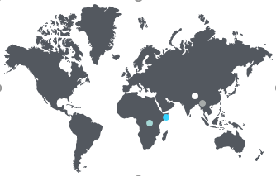
Age, years | Total |  | Female (n=798) |  | Male (n=185)
Age Range (min-max) | 18-89 |  | 18-89 |  | 19-88
Average / Mode Age | 41/31 |  | 39 /31 |  | 45 /27
Health Insurance
No Health Insurance | 51% (498/974) |  | 53% (423/792) |  | 41% (75/182)
Formal Education
Average years | 7 |  | 7 |  | 7.2
Literacy
Speaks English (Well/Very Well) | 25% (240/975) |  | 24% (191/792) |  | 26% (49/183)
US Residence
Average years (min-max) | 5 (0-28) |  | 5 (0-28) |  | 5 (0-28)
Characteristics of Participants, 2014 – Sep. 2019 (n=1003)
Notes:
Enrolled people from 21 countries of origin
30 languages (with interpreters)
Top Four Countries of Origin:
Myanmar (ex-Burma)
Somalia
Bhutan
Democratic Republic of the Congo

Slide 8
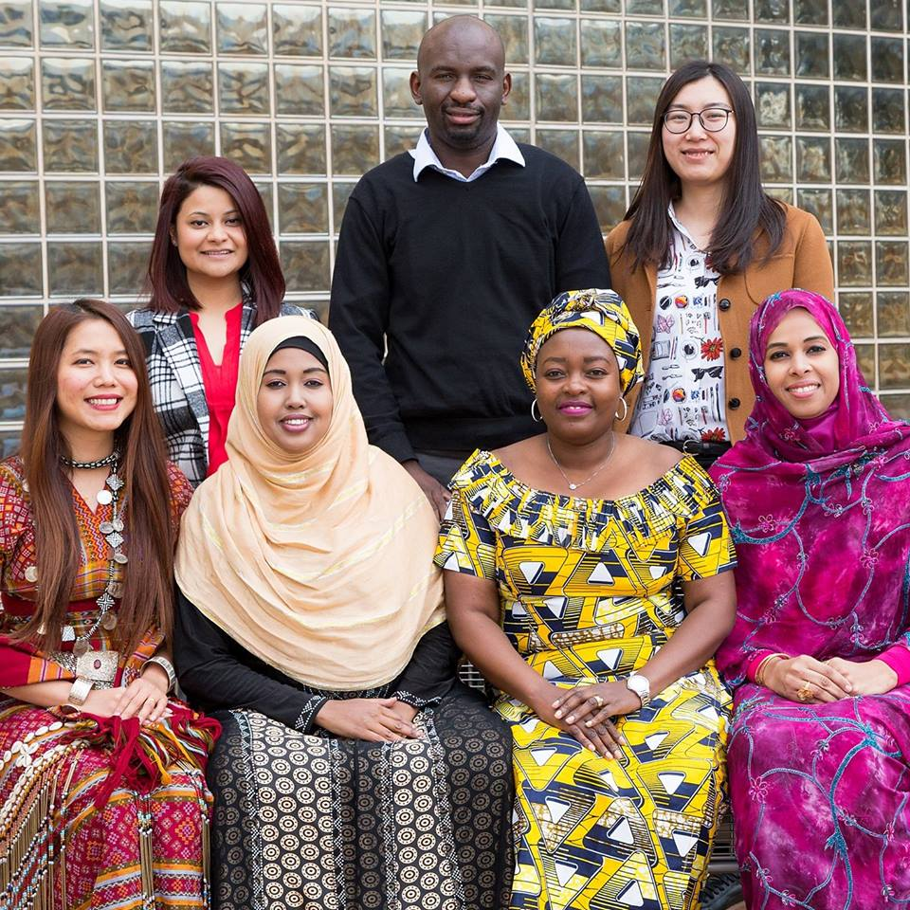
Building Bridges Model

Slide 9
Building Bridges Model
Trauma Informed Screenings
Community Advisors & Collaboration
Participant
Lay Health Educator Outreach and Education
Health Provider Education

Slide 10
BUILDING BRIDGES PROCESS
Outreach, Consent & Enrollment
Housing
Houses of Worship
Cultural Events
Word of Mouth
Education
Adapted from Research Tested Interventions & for each population
13 languages
Small group &
One-on-One Settings
Screenings & Navigation
Appointments
Transportation
Interpretation
Follow-Up

Slide 11
ACTIVITIES
Community Advisor Meeting
Vaccination Event
Health Provider Training
Health Education Session
Scientific Presentation
Team Building

Slide 12
Cervical Cancer Screening
Cultural Groups | Age Eligible, n (%) | Eligible for PAP (among those age eligible), n (%) | Up-to-Date Pap Exams (among those age eligible), n (%) | Never Screened Before (among those eligible), n (%) | Completed screening after enrollment in BBI (among those eligible), n (%) | Never screened before (among those who completed screening in BBI), n (%)
All participants | 768 (77% = 768/1003) | 550 (72% = 550/768) | 218 (28% = 218/768) | 421 (77% = 421/550) | 236 (43% = 236/550) | 181 (77% = 181/236)
Myanmar | 263 (79%) | 203 (77%) | 60 (23%) | 151 (74%) | 96 (47%) | 77 (80%)
Central African Region | 166 (76%) | 116 (70%) | 50 (30%) | 97 (84%) | 42 (36%) | 32 (76%)
Bhutan | 109 (67%) | 100 (92%) | 9 (8%) | 69 (69%) | 47 (47%) | 32 (68%)
Somalia | 124 (76%) | 76 (61%) | 48 (39%) | 57 (75%) | 27 (36%) | 18 (67%)
Arabic speaking | 84 (88%) | 43 (51%) | 41 (49%) | 36 (84%) | 20 (47%) | 18 (90%)
Others | 22 (85%) | 12 (55%) | 10 (45%) | 11 (92%) | 4 (33%) | 4 (100%)
 |  | At Baseline |  |  | Post-Intervention

Slide 13
Breast Cancer Screening
Cultural Groups | Age Eligible, n (%) | Eligible for Mammogram (among those age eligible), n (%) | Up-to-Date Mammogram (among those age eligible), n (%) | Never Screened Before (among those eligible), n (%) | Completed screening after enrollment in BBI (among those eligible), n (%) | Never screened before (among those who completed screening in BBI), n (%)
All participants | 368 (37% = 368/1003 | 312 (85% = 312/368) | 56 (15% = 56/368) | 226 (72% = 226/312) | 183 (59% = 183/312) | 134 (73% = 134/183)
Myanmar | 99 (30%) | 91 (92%) | 8 (8%) | 62 (68%) | 54 (59%) | 38 (70%)
Central African Region | 87 (40%) | 77 (89%) | 10 (11%) | 55 (71%) | 31 (40%) | 22 (71%)
Bhutan | 79 (49%) | 56 (71%) | 23 (29%) | 44 (79%) | 37 (66%) | 31 (84%)
Somalia | 59 (36%) | 54 (92%) | 5 (8%) | 43 (80%) | 36 (67%) | 27 (75%)
Arabic speaking | 39 (41%) | 32 (82%) | 7 (18%) | 20 (63%) | 23 (72%) | 14 (61%)
Others | 5 (19%) | 2 (40%) | 3 (60%) | 2 (100%) | 2 (100%) | 2 (100%)
 |  | At Baseline |  |  | Post-Intervention

Slide 14
Discussion
768 enrolled refugee women were asked about previous cervical and breast cancer screening history.
The majority had never been screened:
77% no prior pap exams
72% no prior mammograms

Slide 15
Discussion: Pap Exam
Myanmar
23%
47%
Bhutan
8%
47%
Arabic speaking
49%
47%*
Baseline
Post - Intervention

Slide 16
Discussion: Mammogram
Central African Region
11%
40%
Somalia
8%
67%
Arabic speaking
18%
72%
Bhutan
29%
66%
Baseline
Post - Intervention

Slide 17
Discussion
Our approach reached an underscreening and culturally and linguistically isolated population of women.
Refugee cancer screening rates still remain low compared to the native born population, but trained bicultural and bilingual lay health educators/navigators can increase screening rates for this vulnerable group.
Future analysis will explore remaining barriers after most known ones were reduced or eliminated.

Slide 18
Needed Research for Future Studies
Reasons for variations in preventive cancer screening acceptance
Cultural reasons:
Gender roles
Religion
FGM
Early marriage
No pap test before marriage
Myths of disease/cancer
Competing priorities
2) Trauma related:
Negative experience with healthcare system
Abuse in exams
Experimentation
Poor interpretation
Fear of exams, fear of results
3) Healthcare system barriers:
Scheduling
Treatment vs preventative medicine
Poor communication
Lack of background health education
Interpreter ethics
Financial/Health Insurance
Transportation

Slide 19
Building Bridges
Lessons Learned (or reinforced)
FLEXIBILITY
PATIENCE
OTHER NEEDS
SELF CARE

Slide 20
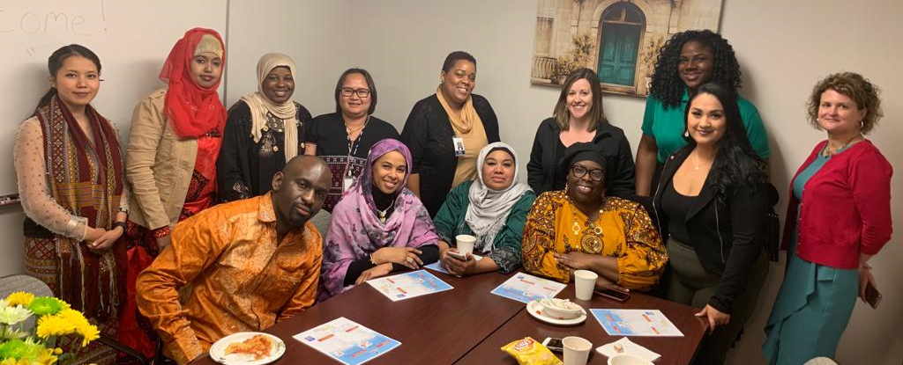
WITH GRATITUDE
APHA 2019
Amy Raines-Milenkov, DrPH, PI, Director
Eva Baker, MPH, Co-Director and Program Manager
Martha Felini, PhD, Evaluator
Elvis Longanga Diese, Health Educator
Sara Onsa, Health Educator
Aisha Ojha, Health Educator
Hlawn Iang, Health Educator
K Paw, Health Educator
Natalie Buhigiro, Health Educator
Anab Abdi, Health Educator
Idara Akpan, Graduate Research Assistant
Lan Yang, Student Biostatistician
Radhika Subedi, former Health Educator
Halimo Mudey, former Health Educator
Laurette Rudasingwa, former Health Educator
Emelda Thein, former Health Educator

