Slide 1
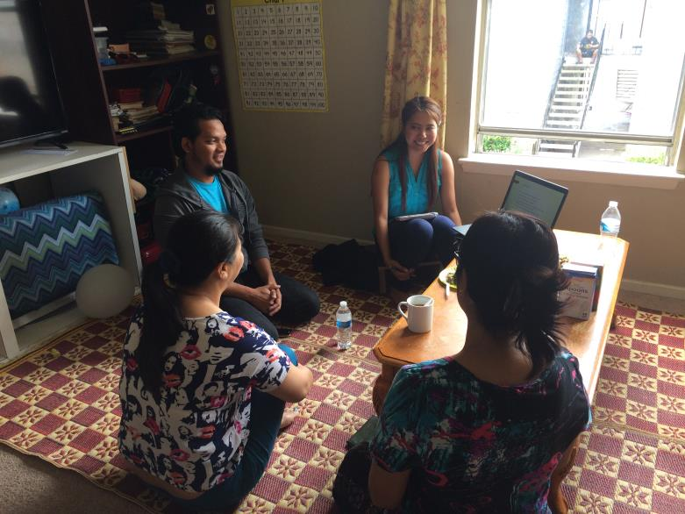
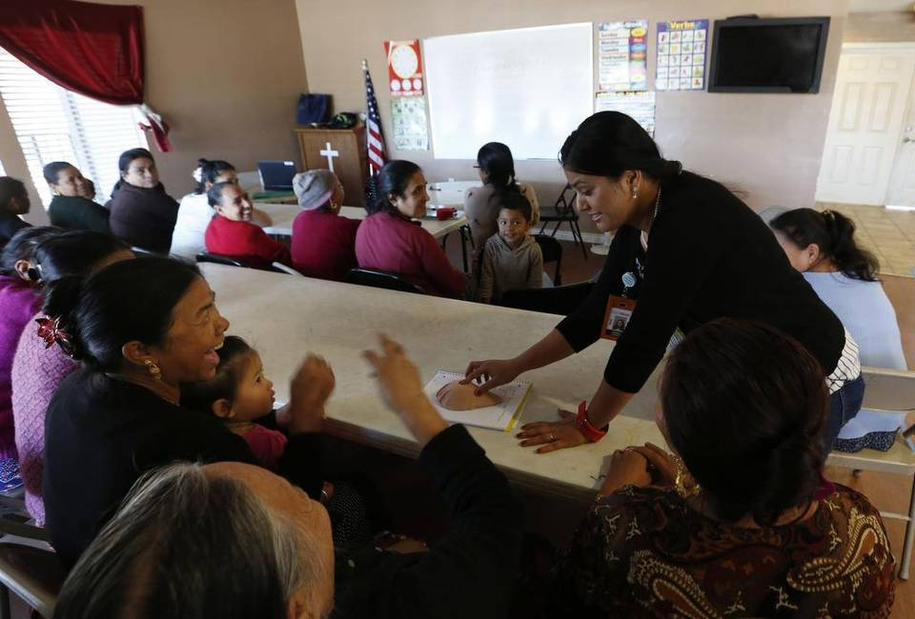
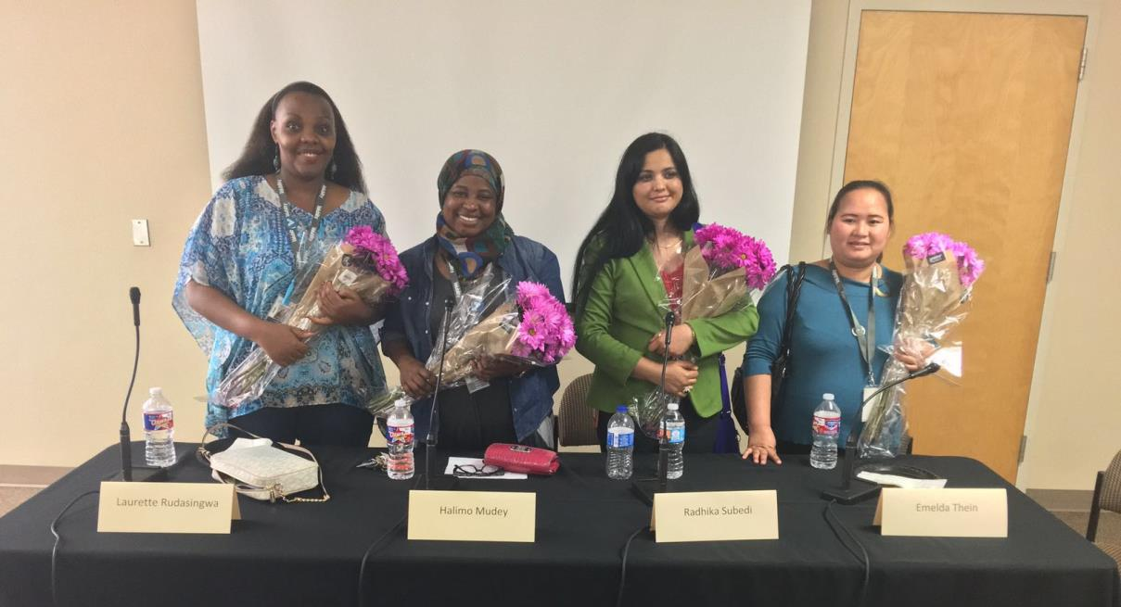
Building Bridges Initiative: Results of an Outreach, Education and Cancer Screening Refugee Health Project
Amy Raines-Milenkov, DrPH, Martha Felini, PhD, Eva Baker, MPH, Iram Qureshi, MPH, Lan Yang, BS, Hlawn Iang, BS
Background
Methods
Results
Conclusion
Resettled refugees, like many immigrant groups, have been shown to have low cancer screening rates thus increasing the chances for higher cancer incidences and mortality rates. The Building Bridges Initiative (BBI) at the University of North Texas Health Science Center is a Cancer Prevention and Research Institute of Texas (CPRIT) funded prevention program that provides breast, cervical and liver cancer education and screening to refugee women and links them into appropriate health services. The purpose of this poster is to describe the results of the first three years of the BBI intervention on adherence to recommended breast and cervical cancer screenings, Hepatitis B screening and vaccination among enrolled participants at baseline and resulting from the intervention.
Trained bicultural and bilingual lay health educators from four refugee communities/regions, (i.e., Bhutanese, Karen, Somali and Central Africa) provide group and individual education to women enrolled in the Building Bridges program in 10 different languages. Educators address barriers related to beliefs (Table 1), culture, language, and structural such as transportation and interpretation. Data for this analysis comes from baseline enrollment and service records. Uptake rates, date of last screen, and prevalence of abnormal screens were analyzed among program participants.
From September 2014 – May 2017, lay health educators enrolled 433 refugee women and 115 refugee men participants.
Cancer prevention education classes were attended by 502 participants. (Picture 1 and 2).
The large majority had never been previously screened or were not following recommended guidelines
75% needed a pap exam,
85% needed a mammogram,
70% did not know their hepatitis B status
The uptake rate of screenings was 93% (511/548).
Total Pap Tests Completed – 168 (53%)
Total Mammograms Completed – 128 (57%)
Total Hep B Screen Completed – 215 (56%)
Of those screened, navigation services were provided for:
11 Abnormal Cervical Screens
15 Abnormal Mammograms
22 Positive Hepatitis B Screens
Among 100 age appropriate women, 47 women started the HPV vaccine, and 23 (49%) completed the entire series.
As a result of CPRIT funding, we were able to reach a population of underserved women, many who had never received a pap or cervical cancer screening. The lay health worker model, which focuses on natural systems in the community setting, was effective in overcoming many of the system-level, cultural, linguistic and structural barriers that prevent refugee women from receiving timely and life-saving cancer screenings.
Picture 4: Flyer
in Burmese
Table 1: BBI Participants Cancer and Screening Beliefs and Experiences
“Cancer cannot be treated.”
Picture 2: Small group education session
“Many women from my country have had abuse and rape from doctors during medical check ups. Sometimes, even though the doctor rapes women in his clinic, the doctor is the only one in the region so they are not able to do anything about it.”
Picture 3: Panel Discussion for Health Providers
“God is good, so we don’t need to be tested for cancer.”
Picture 1: Group education session
“Sometimes when someone has Hepatitis B, the traditional healers can use a metal stick that has been heated in fire to press three dots on the stomach to cure it.”

