Slide 1
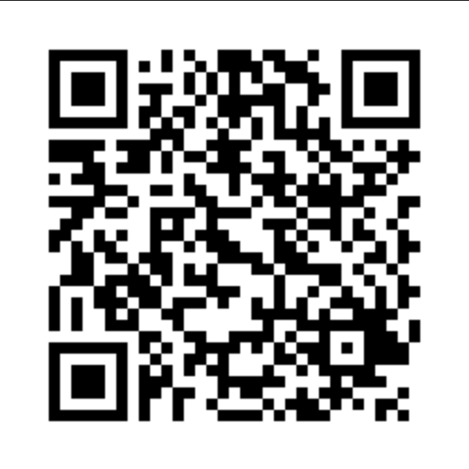
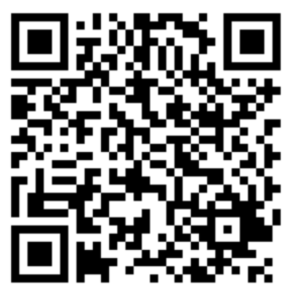
Naloxone training (brand name Narcan)
Please complete the Registration
Please complete the Pre-survey

Slide 2
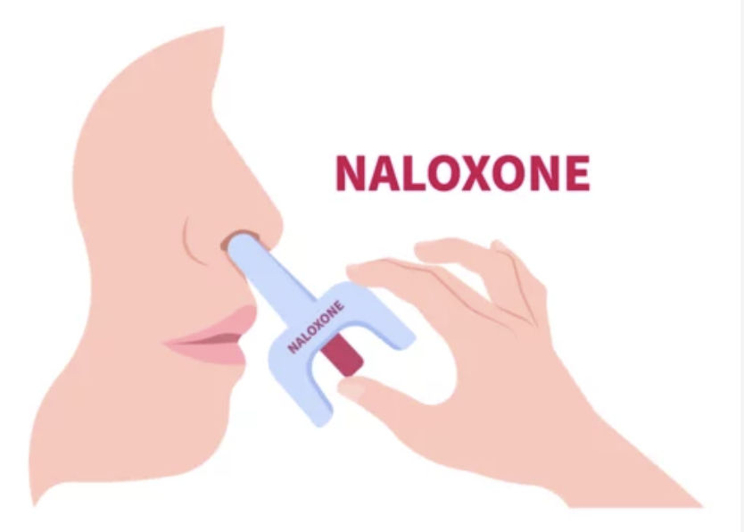
By the end of this workshop, you will be able to:
Discuss the harm of Fentanyl/opioids when misused
Recognize the signs of an opioid overdose.
Respond to an opioid overdose by using nasal Naloxone/Narcan (Two Pack).
Safeguard the community you serve from accidental exposure and overdose death.

Slide 3
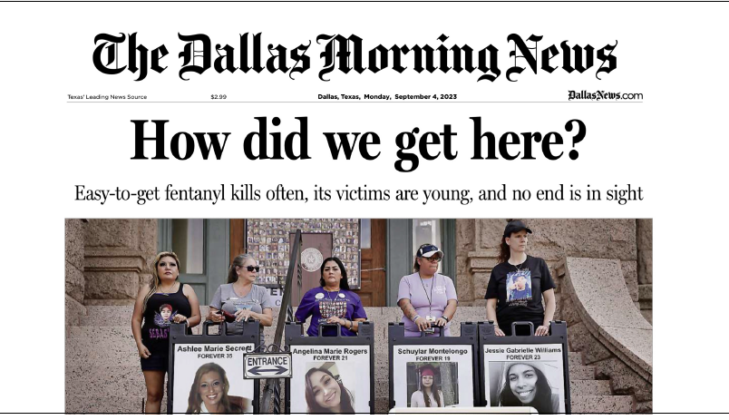

Slide 4
Why is this Opioid epidemic Occurring?
Increased opioid prescriptions.
Polydrug use especially for pain.
Sold through illegal drug markets.
Opioid medications are highly addictive.
Examples of opioids include heroin, fentanyl, oxycodone (OxyContin®), hydrocodone (Vicodin®), codeine, & morphine.
Notes:
The number of drug overdose deaths increased by nearly 30% from 2019 to 2020 and has quintupled since 1999. Nearly 75% of the 91,799 drug overdose deaths in 2020 involved an opioid. From 2019 to 2020, there were significant changes in opioid-involved death rates.
Centers for Disease Control and Prevention. (2022, May 23). Opioid basics. Centers for Disease Control and Prevention. https://www.cdc.gov/opioids/basics/index.html

Slide 5
Notes:
https://www.youtube.com/watch?v=pzm0bPrWX8c&t=2s

Slide 6
Notes:
CDC graph at https://www.cdc.gov/opioids/basics/epidemic.html
This rise in opioid overdose deaths can be outlined in three distinct waves.
1. The first wave began with increased prescribing of opioids in the 1990s, with overdose deaths involving prescription opioids (natural and semi-synthetic opioids and methadone) increasing since at least 199³.
2. The second wave began in 2010, with rapid increases in overdose deaths involving heroin⁴.
3. The third wave began in 2013, with significant increases in overdose deaths involving synthetic opioids, particularly those involving illicitly manufactured fentanyl^{5,6,7}. The market for illicitly manufactured fentanyl continues to change, and it can be found in combination with heroin, counterfeit pills, and cocaine.⁸

Slide 7
Notes:
Centers for Disease Control and Prevention. (2022, May 23). Opioid basics. Centers for Disease Control and Prevention. https://www.cdc.gov/opioids/basics/index.html

Slide 8
Notes:
Centers for Disease Control and Prevention. (2022, May 23). Opioid basics. Centers for Disease Control and Prevention. https://www.cdc.gov/opioids/basics/index.html

Slide 9
Notes:
Centers for Disease Control and Prevention. (2022, May 23). Opioid basics. Centers for Disease Control and Prevention. https://www.cdc.gov/opioids/basics/index.html

Slide 10
Statistics
Overdose deaths remain a leading cause of injury-related death in the United States.
In 2016, more than 11.5 million Americans reported misusing prescription opioids in the past year.
Synthetic opioid-involved death rates increased by over 56% from 2019 to 2020 and accounted for over 82% of all opioid-involved deaths in 2020.
Notes:
Centers for Disease Control and Prevention. (2022, May 23). Opioid basics. Centers for Disease Control and Prevention. https://www.cdc.gov/opioids/basics/index.html

Slide 11
What is Fentanyl?
Pharmaceutical Fentanyl is a synthetic opioid, approved for treating severe pain.
It is prescribed in the form of transdermal patches (placed on the skin) or lozenges and can be diverted for misuse and abuse in the United States.
It is 50 to 100 times more potent than morphine.
It can also be used for sale on the streets and disguised using counterfeit or other drugs.
It can additionally be manufactured illegally for sale on the streets.
Notes:
Centers for Disease Control and Prevention. (2022, May 23). Opioid basics. Centers for Disease Control and Prevention. https://www.cdc.gov/opioids/basics/index.html

Slide 12
Notes:
Texas Targeted Opioid Response. It’s available at: https://youtu.be/AR7NuBetJJg?si=rwEz_qDfHweZqwA5

Slide 13
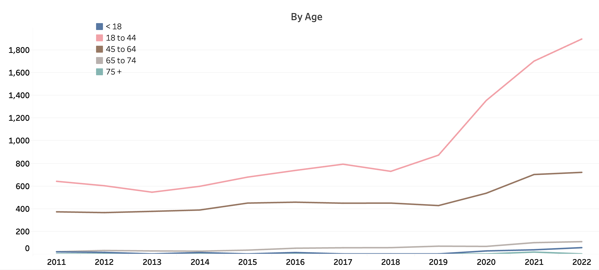
Trends in Death from Opioid Overdose by Age
Notes:
Opioid overdose deaths by age. Conveys that the issue impacts people of all age groups, with most of the deaths occurring among adults ages 18-44. The data is available at https://healthdata.dshs.texas.gov/dashboard/drugs-and-alcohol/drug-related-deaths.

Slide 14
Notes:
DEA https://www.dea.gov/onepill

Slide 15
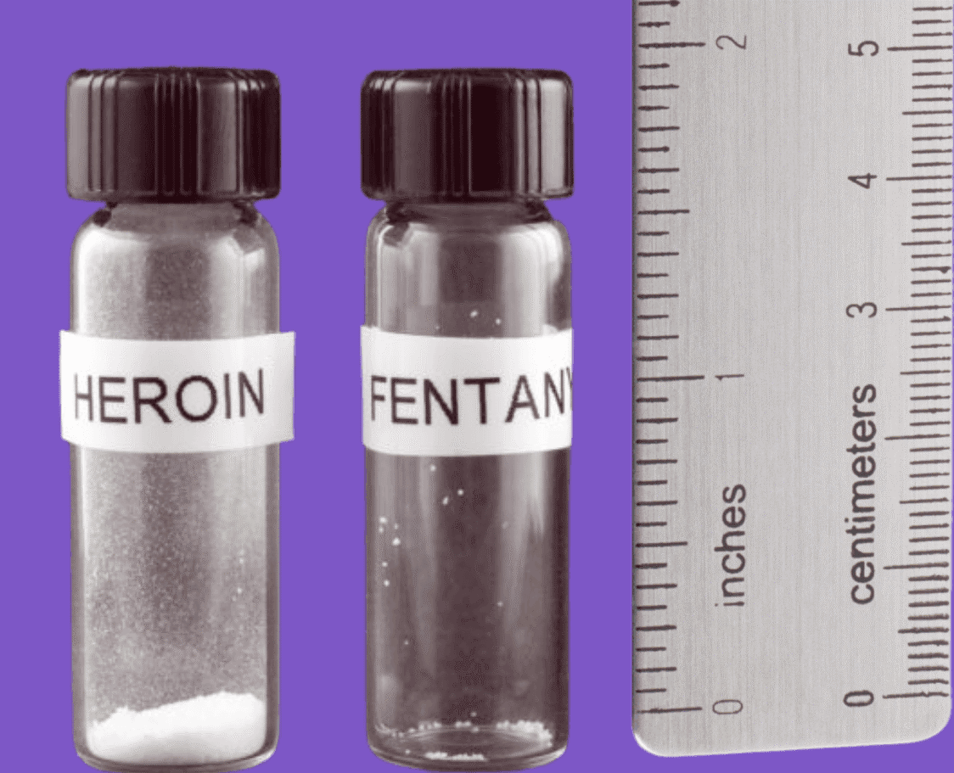
Signs of an opioid overdose:
Small, constricted “pinpoint pupils”
Face is extremely pale and/or feels cold or clammy to the touch
Body goes limp
Fingernails or lips have a purple or blue color
Vomiting or making gurgling noises
Cannot be awakened or unable to speak
Breathing or heartbeat slows or stops
Notes:
CDC https://www.cdc.gov/opioids/overdoseprevention/index.html

Slide 16
What is naloxone (Narcan)?
Naloxone is a medicine that rapidly reverses an opioid overdose
It blocks opioid receptors and reverses and blocks the effects of opioids.
Naloxone can quickly restore normal breathing to a person if their breathing has slowed or stopped due to opioid overdose.
Naloxone does not affect someone who does not have opioids in their system.
Notes:
Centers for Disease Control and Prevention. (2022, February 8). Naloxone. Centers for Disease Control and Prevention. https://www.cdc.gov/opioids/naloxone/index.html
CDC https://www.cdc.gov/opioids/overdoseprevention/reverse-od.html

Slide 17
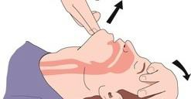
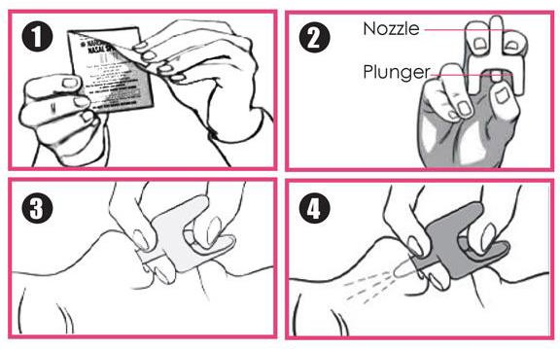
Giving Naloxone
Check for Responsiveness
Call 911
Roll onto back
Open Narcan package
Head tilt – Chin Lift
Insert fully into 1 nostril
Depress plunger
Notes:
Mayo Foundation for Medical Education and Research. (2023, May 1). Naloxone (nasal route) proper use. Mayo Clinic. https://www.mayoclinic.org/drugs-supplements/naloxone-nasal-route/proper-use/drg-20165181

Slide 18
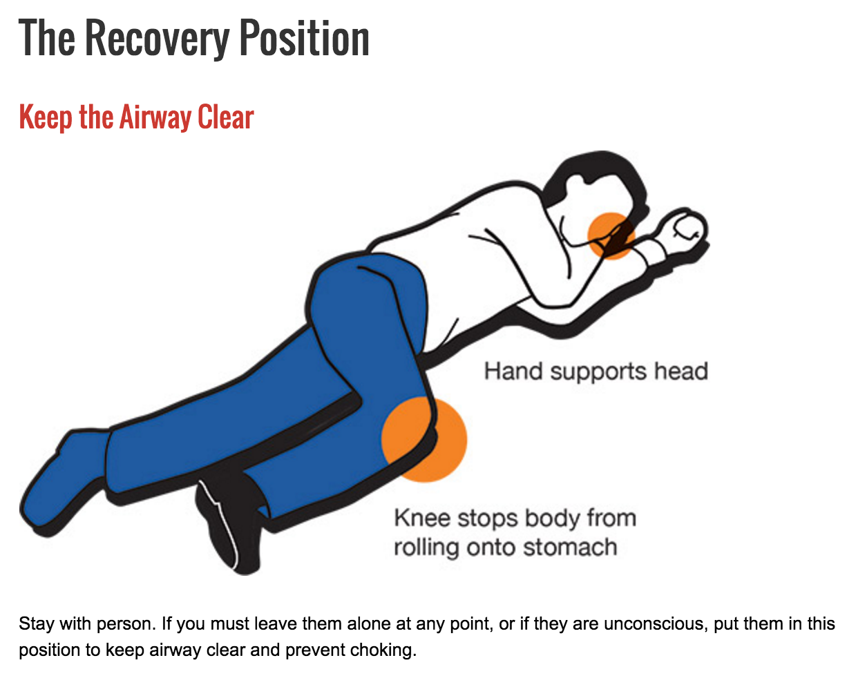
Recovery Position
Move the patient to their left side (recovery position) after giving Narcan.
Watch the patient closely.
Additional doses may need to be given every 2 to 3 minutes until the patient responds or emergency medical assistance arrives.
Narcan can wear off in 15 minutes
If EMS not arrived, and the patient goes back into respiratory distress
Administer second dose
Notes:
Mayo Foundation for Medical Education and Research. (2023, May 1). Naloxone (nasal route) proper use. Mayo Clinic. https://www.mayoclinic.org/drugs-supplements/naloxone-nasal-route/proper-use/drg-20165181

Slide 19
Naloxone reverses the effects of opioid substances.
Naloxone does not reverse the effects of non-opioid substances.
However, because substances are sometimes mixed with opioids, naloxone should still be used.
Giving naloxone will not harm someone if you give it to them and they are not overdosing on an opioid.
Notes:
Centers for Disease Control and Prevention. (2022, February 8). Naloxone. Centers for Disease Control and Prevention. https://www.cdc.gov/opioids/naloxone/index.html

Slide 23
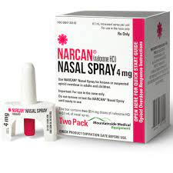
NARCAN Sources
Where to obtain:
More Narcan Please
UT Health San Antonio School of Nursing
www.naloxonetexas.com
Reacting to Opioid Overdose – Denton
www.roonow.org
Sharon Roland at 214-418-4769.

Slide 24
Expired Prescription Disposal
Dispose of Unused or Expired Prescriptions Properly
You can find your nearest drug take-back site:
https://uh.edu/pharmacy/research/centers-and-institutes/the-premier-center/community-outreach/
Naloxone Expiration Info
Expiration between 24-36 months
Call manufacturer or visit website to verify if expiration date has been extended.
Notes:
University of Houston: For awareness, safe disposal materials are available for pick up at community locations throughout Texas. Learn more at https://uh.edu/pharmacy/research/centers-and-institutes/the-premier-center/community-outreach/.

Slide 25
Website with Training Toolkit
Go to Website
Notes:
https://www.unthsc.edu/one-pill-kills/narcan-training/

Slide 26
Questions

Slide 27
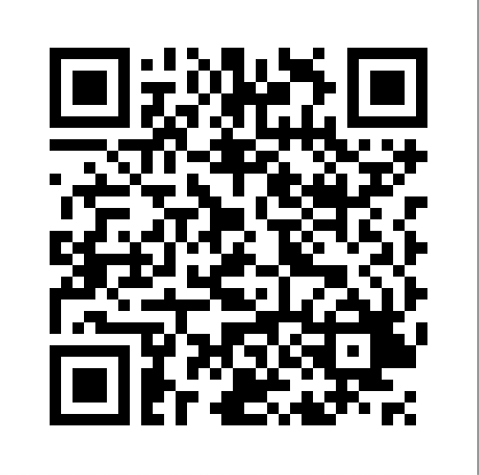
Let’s Practice
Please complete the Post-survey

